Slide 1
Cluster Analysis Project Report Identification and Profiling of Customers for a Software Company
Prepared By: Subhajit Sarkar
Date: 11/02/2018
Analysis Software: SAS

Slide 2
Report Contents
Business Key Parameters
Project Objective
Description of Variables
Cluster Development
Outcomes
Conclusion
Business Strategy

Slide 3
Business Key Parameters
Price Paid
Discount
Sales
Unit Sold

Slide 4
PROJECT OBJECTIVE
The project aims to construct a cluster analysis model for a software company on the basis of a given set of variables. Cluster analysis or clustering is the task of grouping a set of objects in such a way that objects in the same group (called a cluster) are more similar (in some sense) to each other than to those in other groups (clusters). It is a main task of exploratory data mining, and a common technique for statistical data analysis, used in many fields, including machine learning, pattern recognition, image analysis, information retrieval, bioinformatics, data compression, and computer graphics.

Slide 5
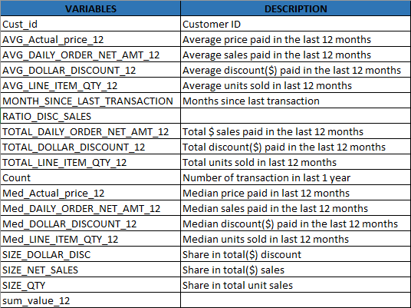
DESCRIPTION OF VARIABLES

Slide 6
CLUSTER DEVELOPMENT PROCESS
Cleaning/Sanity Check
Outlier Treatment
Missing Value Treatment
Multicollinearity Treatment using Factor Analysis
Variables standardization
Cluster solution development and validation

Slide 7
CLEANING/SANITY CHECK
The given dataset doesn’t have any missing values but the variables has many outliers. The outliers has been detected by checking the difference between Mean and Median. Scatter plotting has also been used to find the outliers. PROC MEANS and PROC UNIVARIATE procedures has been used in SAS for Outlier detection. The below mentioned variables has higher outliers. The outliers has been capped with the values mentioned inside parenthesis.
Note: If a particular row has multiple outliers across variables, then delete the observation. Rows deleted: 48,58,68,184, 279, 616, 696,698

Slide 8
VARIABLES WITH OUTLIERS (Higher Value Capping)
TOTAL_DAILY_ORDER_NET_AMT_12 (80925)
AVG_DAILY_ORDER_NET_AMT_12 (11554.2)
TOTAL_LINE_ITEM_QTY_12 (80)
AVG_LINE_ITEM_QTY_12 (5)
TOTAL_DOLLAR_DISCOUNT_12 (536197)
AVG_DOLLAR_DISCOUNT_12 (21945.75)
SIZE_NET_SALES (1.905025)
SIZE_QTY (1.650989)
SIZE_DOLLAR_DISC (2.585263)
RATIO_DISC_SALES (6.88889)
med_DAILY_ORDER_NET_AMT_12 (22500)
med_LINE_ITEM_QTY_12 (12)
med_DOLLAR_DISCOUNT_12 (21945.75)
count (31)
sum_value_12 (498465)

Slide 9
FACTOR ANALYSIS
Factor analysis is a way to take a mass of data and shrinking it to a smaller data set that is more manageable and more understandable. Factors are linear combination of variables. Each factor has some part of each variable into it. Factors will be rotated in N-Dimensional plane till they become mutually orthogonal and hence independent from each other. Factors thus generated has no multicollinearity.

Slide 10
FACTORS SELECTION
By Factor Analysis, we consider those factors which explain 95% of total variation with data. The selected variables after Factor Analysis are:
med_Actual_price_12
AVG_Actual_price_12
TOTAL_DAILY_ORDER_NET_AMT_12
AVG_LINE_ITEM_QTY_12
AVG_DOLLAR_DISCOUNT_12
SIZE_QTY
RATIO_DISC_SALES
med_LINE_ITEM_QTY_12
med_DOLLAR_DISCOUNT_12
MONTH_SINCE_LAST_TRANSACTION
sum_value_12

Slide 11
STANDARDIZATION
In statistics, standardized variables are variables that have been standardized to have a mean of 0 and a standard deviation of 1. The variables are rescaled using the z-score formula. Standardizing makes it easier to compare scores, even if those scores were measured on different scales. It also makes it easier to read results from regression analysis and ensures that all variables contribute to a scale when added together.

Slide 12
CRITERION CHECK FOR CLUSTER FORMATION
Individual R-Squared >= 0.25. Every variable used in cluster formation generates an R-Squared. This measures the worth of the variable in the cluster formation. The final model must have only those variables for which R-Squared >= 0.25
Overall R-Squared >= 0.5. This measure the overall goodness of fit of the model and should be >= 0.5.
Approximate Expected Overall R-Squared > =0.3 (This is the R-Squared which the model would have generated if there was no Multicollinearity among the variables used in cluster formation). It should be >= 0.3.
The Difference Between Overall R-Squared and Approximate Expected Overall R-Squared Should Not Be Greater Than 0.2. A higher difference indicates unacceptable amount of Multicollinearity among the variables used in cluster formation.
RMS Standard Dev < =1.4. This is a measure of within cluster homogeneity. It should be < =1.4 for each cluster. A higher value for any cluster indicates presence of outliers in that cluster.
Distance between Cluster Centroids >= 1.4. This is a measure of across cluster heterogeneity. The distance between centroid of any cluster with that of the nearest cluster should be >= 1.4
Number of Clusters Should Be Between 4 and 15.
Percentage of Frequency in Each Cluster Should Be < = 35.

Slide 13
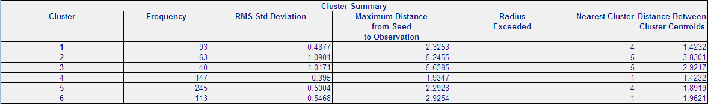
SAS OUTPUT FOR CLUSTERS
RMS Standard Dev (< =1.4) criteria matched
Distance between Cluster Centroids (>= 1.4) criteria matched

Slide 14
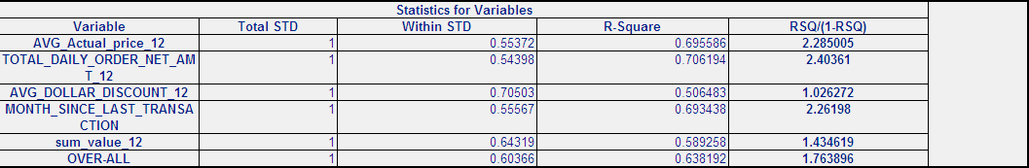

STATISTICS FOR VARIABLES
Individual(>=0.25) and Overall R-Square(>=0.5) criteria matched
Approximate Expected Overall R-Squared > =0.3 criteria matched
The Difference Between Overall R-Squared and Approximate Expected Overall R-Squared (<0.2) criteria matched

Slide 15
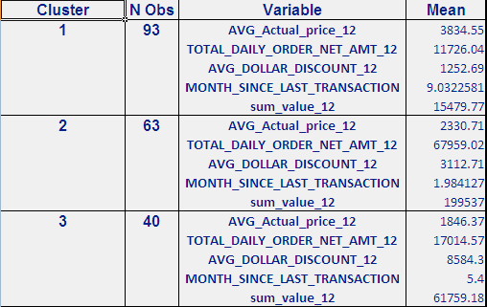
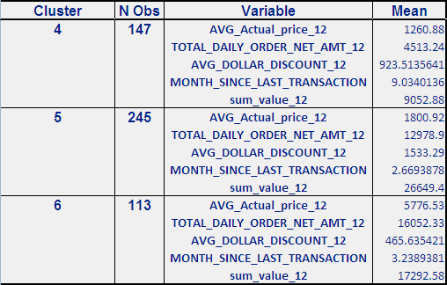
CLUSTER MEAN
Cluster mean with respect to each variable

Slide 16
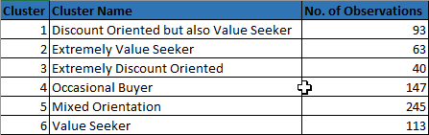
CLUSTER VALIDATION

Slide 17
CLUSTER PROFILING

Slide 18
DISTRIBUTION OF DATA ACROSS CLUSTERS

Slide 19
VARIABLES ACROSS CLUSTERS
Identification and Profiling of Customers for a Software Company

Slide 20
CONCLUSION
Based on the analysis and the six generated clusters, we found six different types of customers
First type of customers are Discount Oriented but also Value Seeker.
Second type of customers are Extremely Value Seeker
Third type of customers are Extremely Discount Oriented
Fourth type of customers are Occasional Buyer
Fifth type of customers are Mixed Oriented
Sixth type of customers are Value Seeker

Slide 21
BUSINESS STRATEGY
You realize that not every customer is similar and you need to have different strategies to attract different customers. You appreciate the power of customer segmentation to deliver superior results with optimized cost.
By working with clusters, software company may be able to increase their efficiency and effectiveness by directing services toward specific groups of customers.
As a result, they can effectively and efficiently streamline marketing efforts, workforce development and produce greater return on investments.

